Slide 1
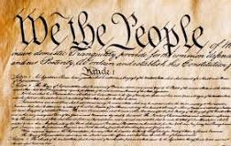
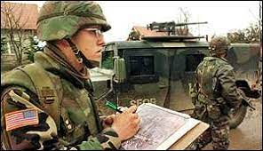
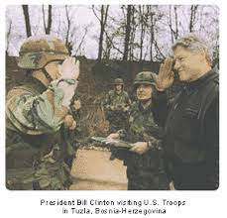
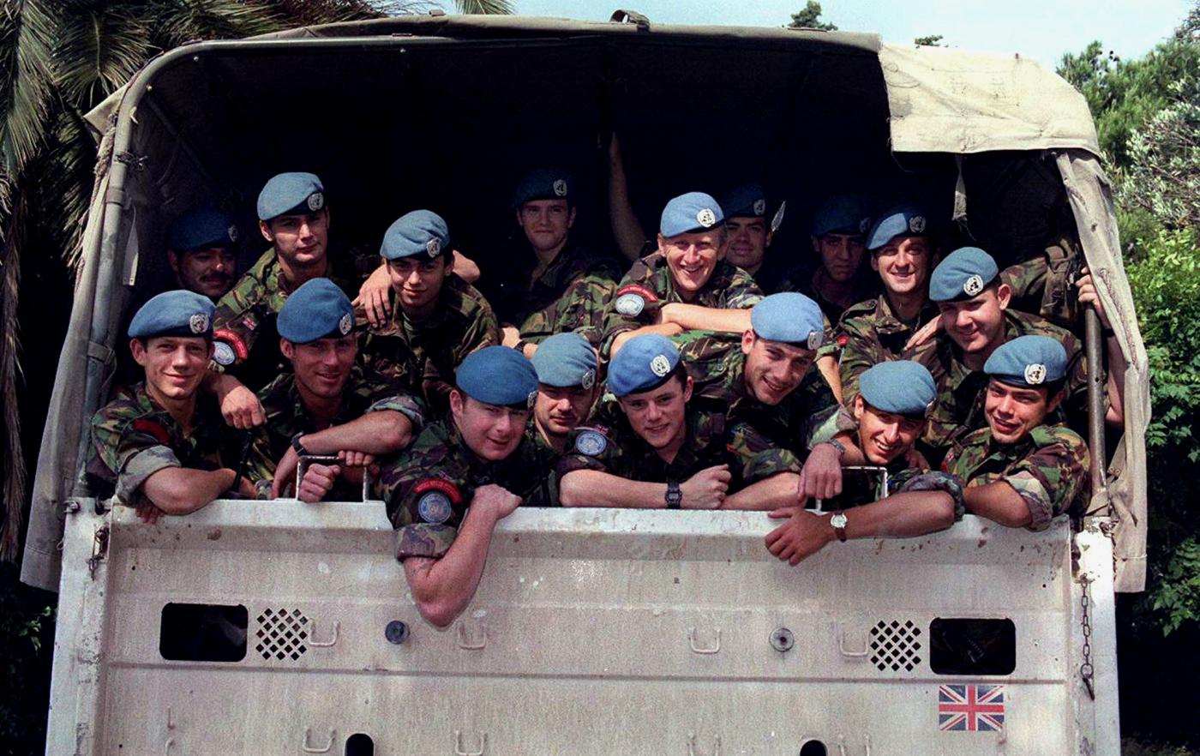
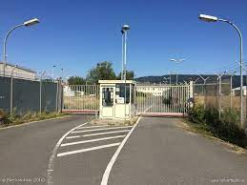
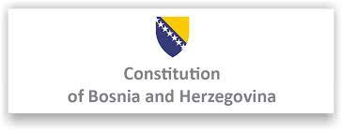
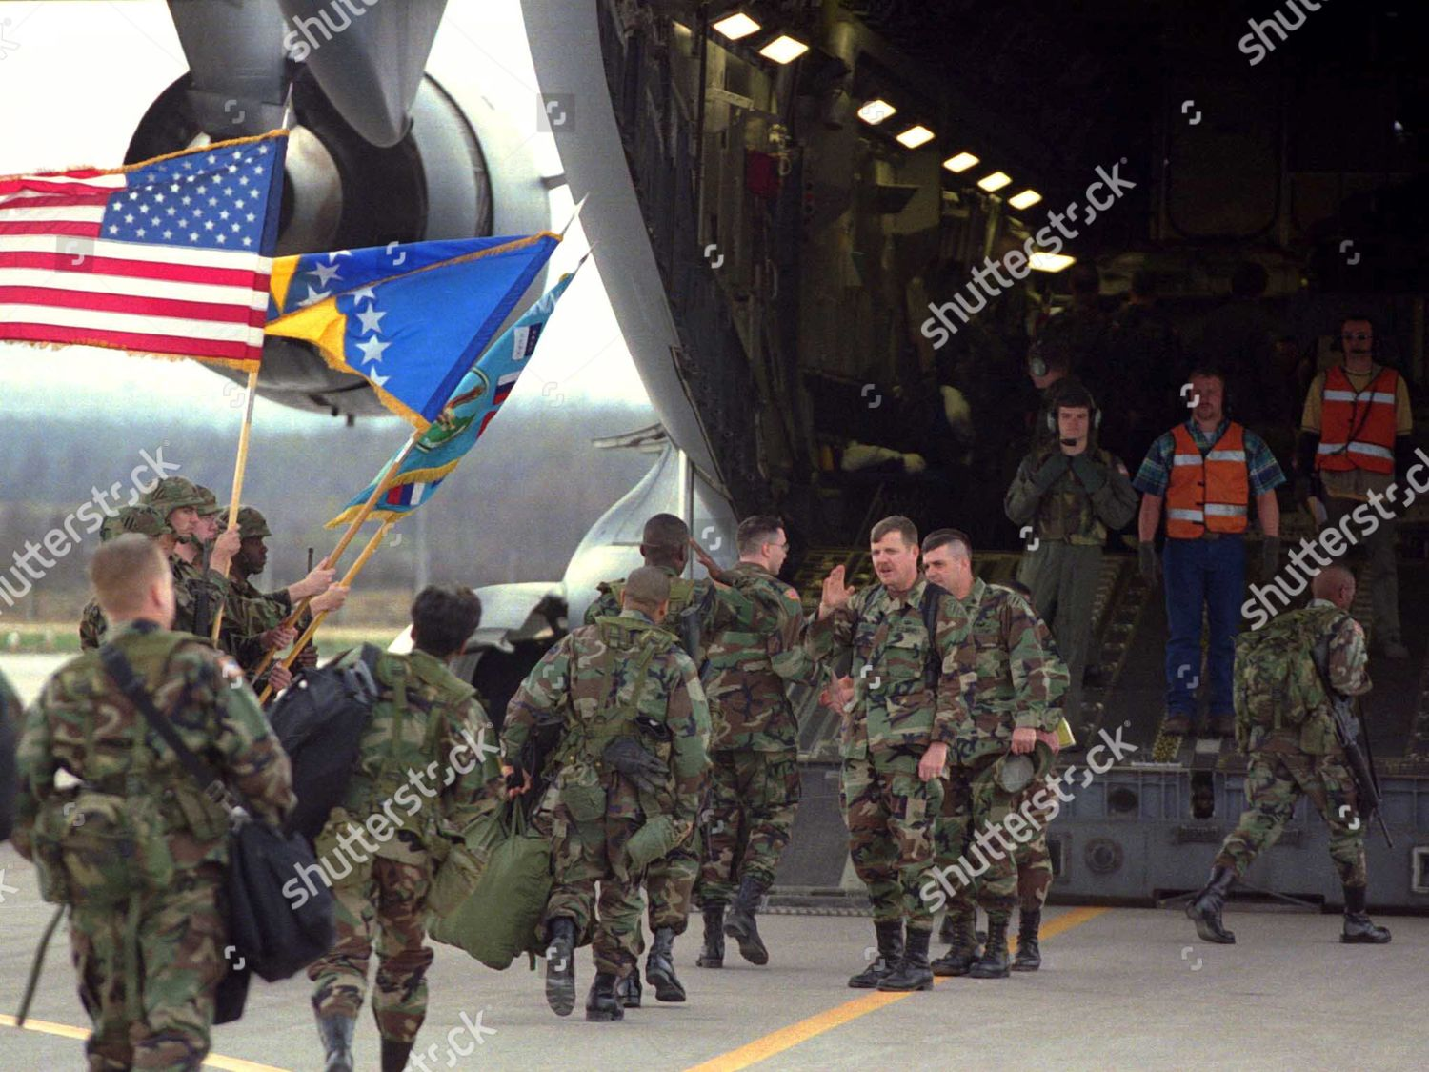
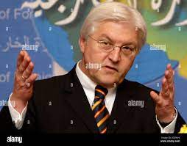
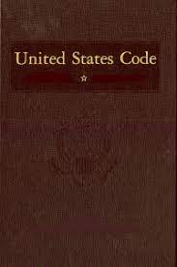

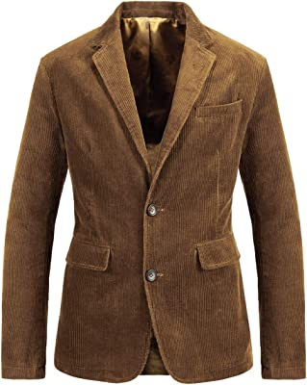
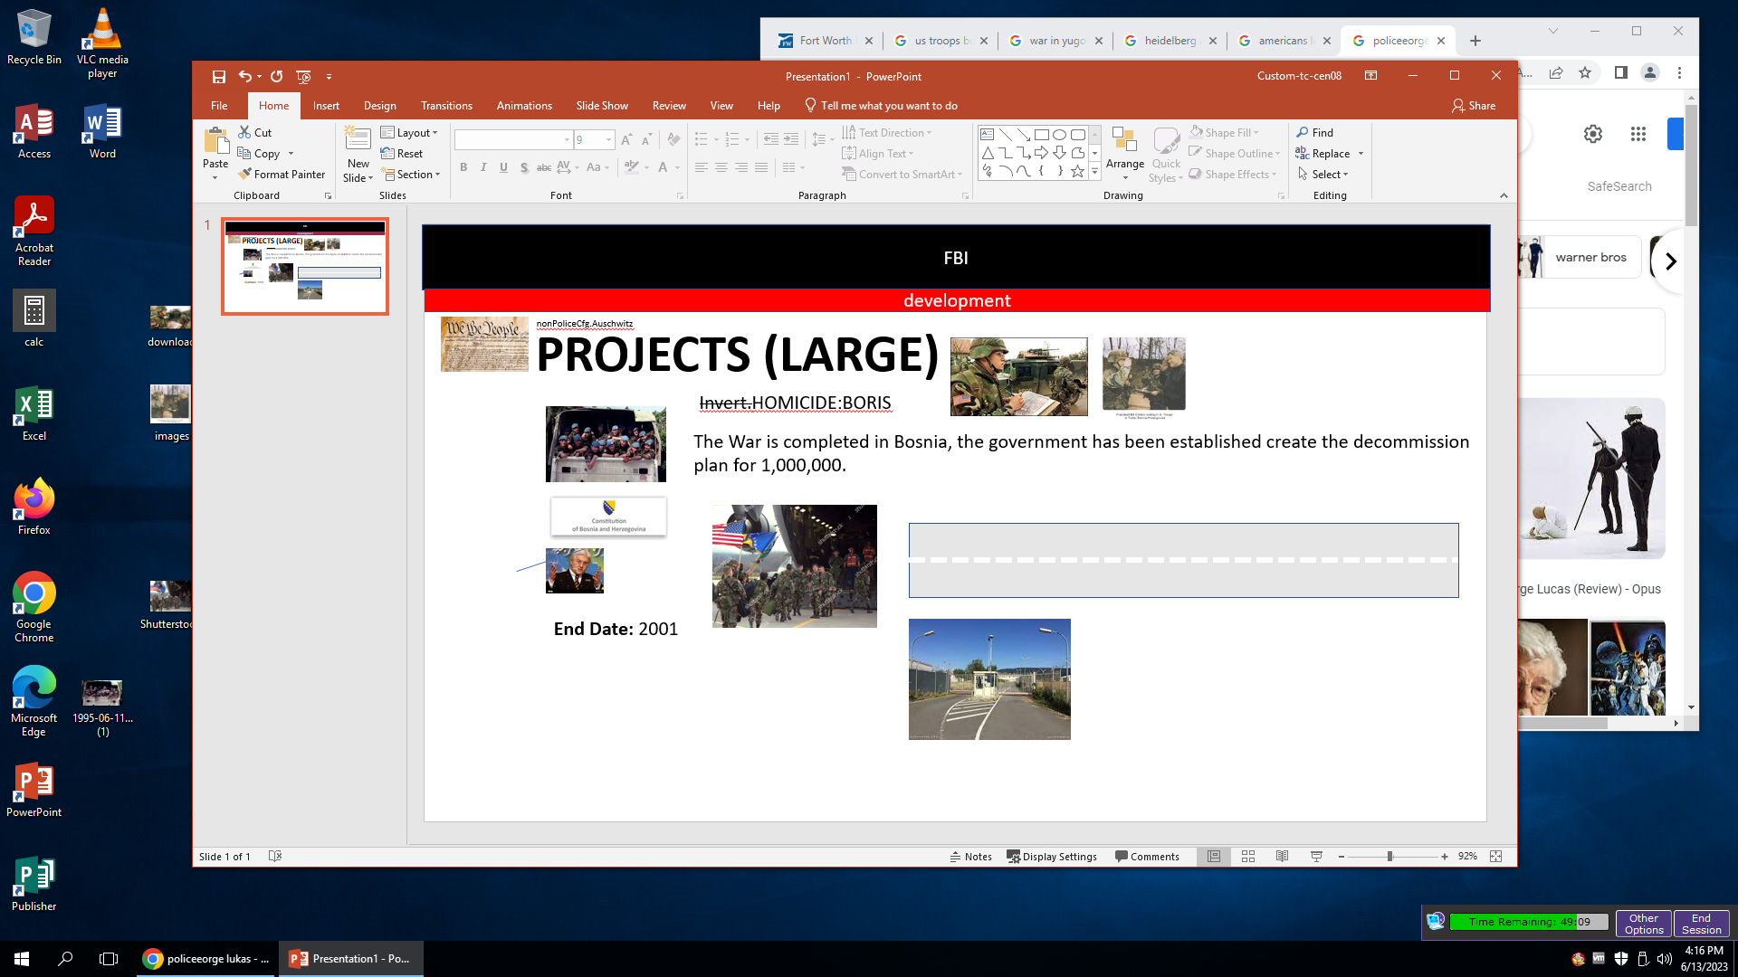
FBI
development
nonPoliceCfg.Auschwitz
PROJECTS (LARGE)
Invert.HOMICIDE:BORIS
The War is completed in Bosnia, the government has been established create the decommission
plan for 1,000,000.
End Date: 2001

Slide 2
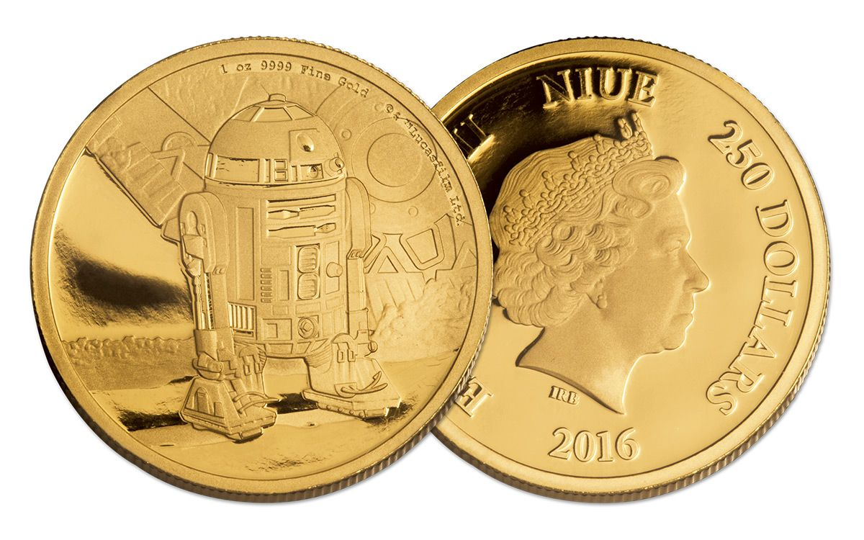
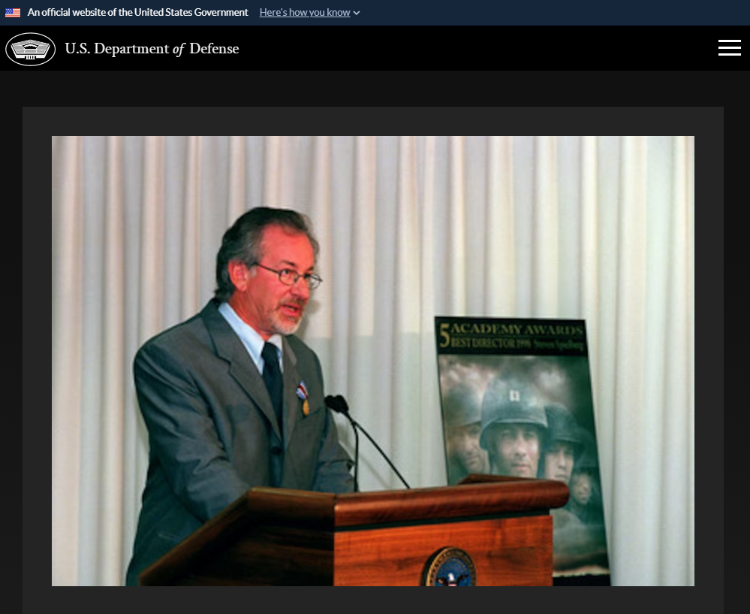
FBI
development
PROJECTS (LARGE)
nonPoliceCfgLogical “Saving Private Ryan"
0.1 red/black CPVA.MAINSTREET.DISNELAYNE(britnety).INTENET PAYMENTS

Slide 3
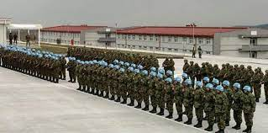
FBI
development
nonPoliceCfg.Auschwitz
PROJECTS (LARGE)
nonPoliceCfg.UNITED NATIONS (MP Peace Keepers)

Slide 4
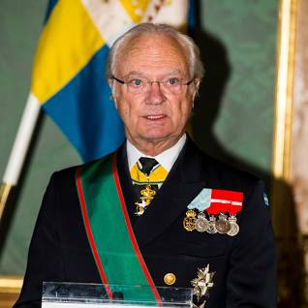
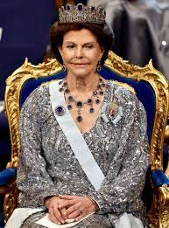
FBI
development
nonPoliceCfg.Auschwitz
Balconies
- 1983 Saint Klaus(Zyante, Santa Cruz, Ca)
- 2004 Auschwitz(HOMICIE:LUX:COINTOWN)
- 2007/8 PENTAGON(deere parke ave)
PROJECTS (LARGE)
0.1 nonPoliceKing[].nonPoliceCfgLoigal[]
Development
CPVA

Slide 5
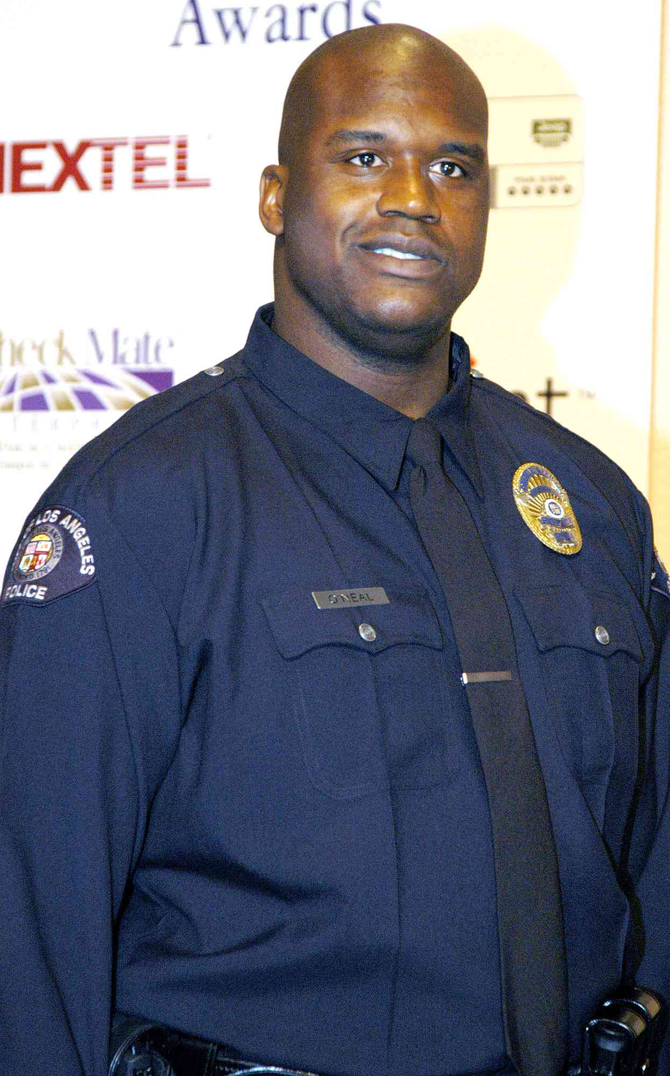
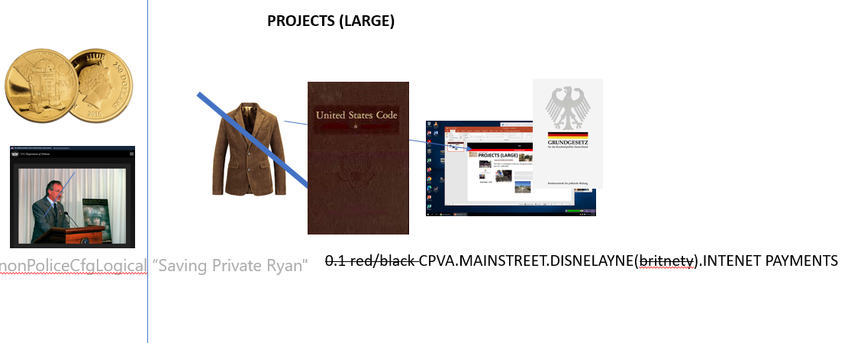
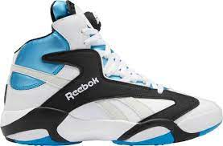
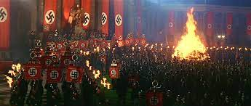
FBI
development
2005 IPX.INT.LARRY.SQ.Jimmy.Pickup
- 0.1 HOMICIDE:GHOST (larry is not there)
0.1 HOMICIDE:TRANSVESTITE
0.1 HOMCIDE:JOERG

Slide 6
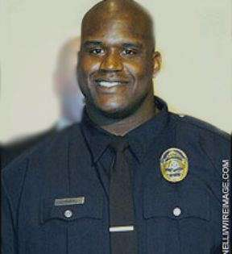

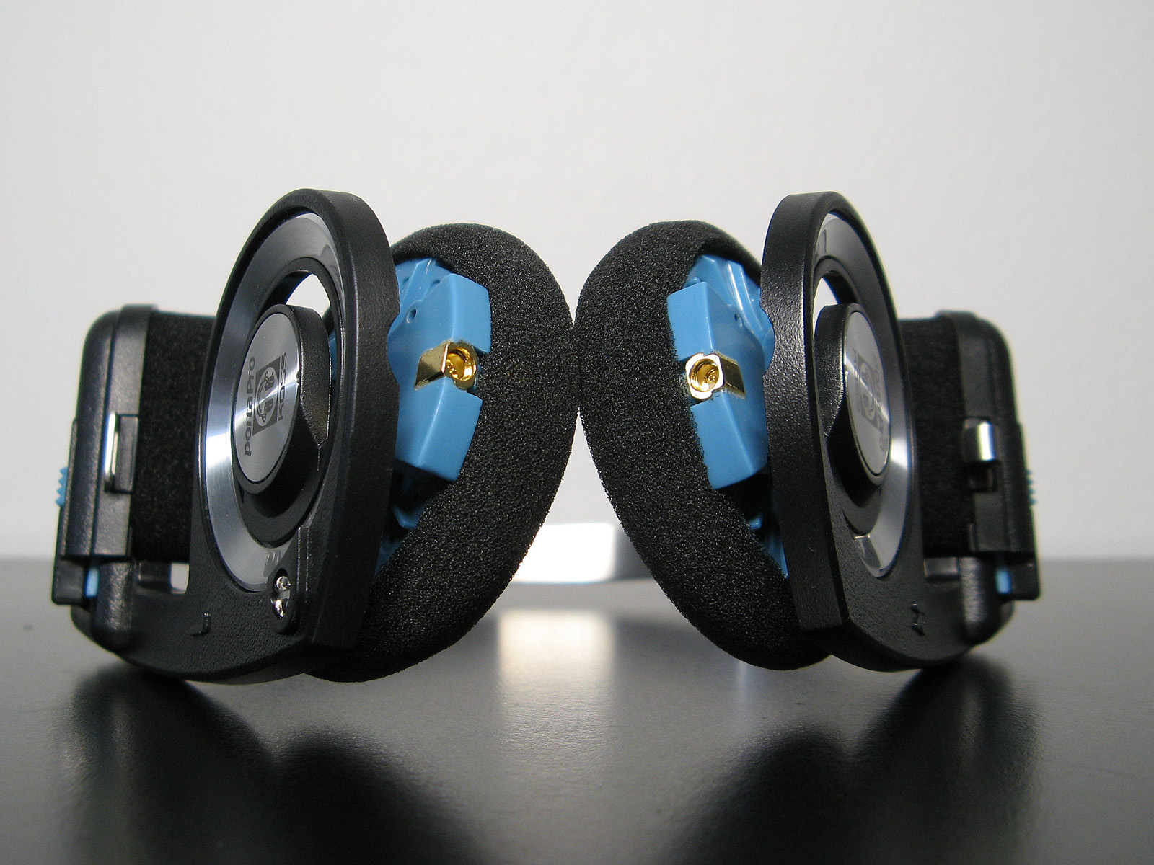
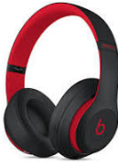
FBI
development
CAR
(carl-benz-strasse)
41.WHERE IS CINDYS COCCAIN CHART?
1994
2016
Cindy’s Cocain

Slide 7

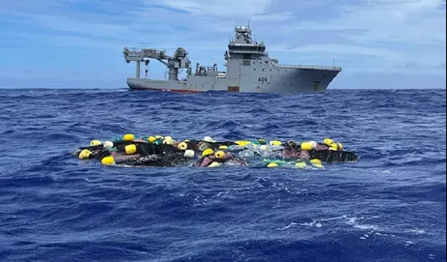
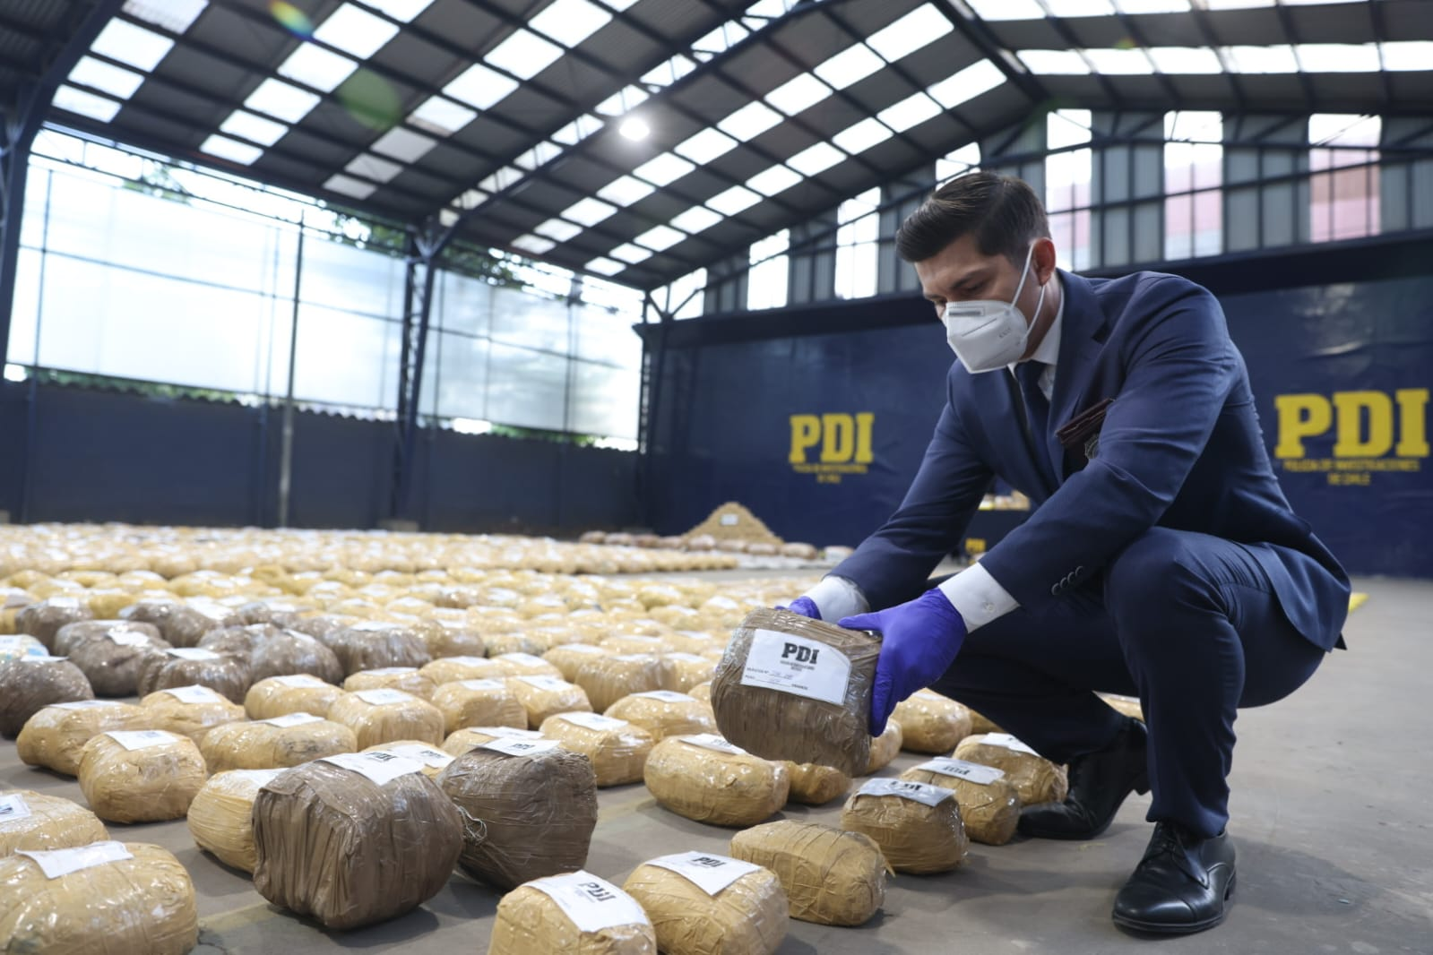
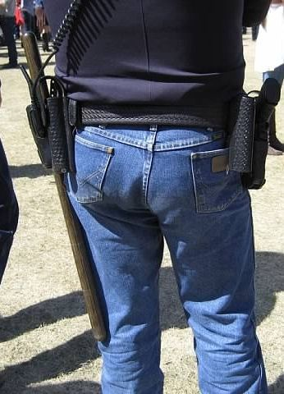
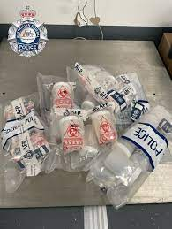
FBI
development
PROJECTS (LARGE)
NAT(Australia).DEA(cocain)
1Kg ( home)
10 Kg (tv)
500lbs (tv police)
nonPoliceContentItem
Cindy’s Cocain
Austriala
Australia
1994 Post Exchange Levis
Tried Joel’s Shoes
= 1g Cocain

Slide 8
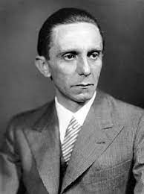
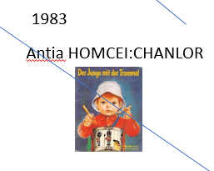
FBI
development
2005 IPX.INT.LARRY.SQ.Jimmy.Pickup
- 0.1 HOMICIDE:GHOST (larry is not there)
0.1 HOMICIDE:TRANSVESTITE
0.1 HOMICIDE:JOERG
POLICE SIRENS
Rothshild.*

Slide 9
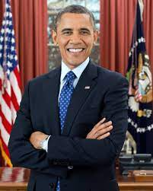

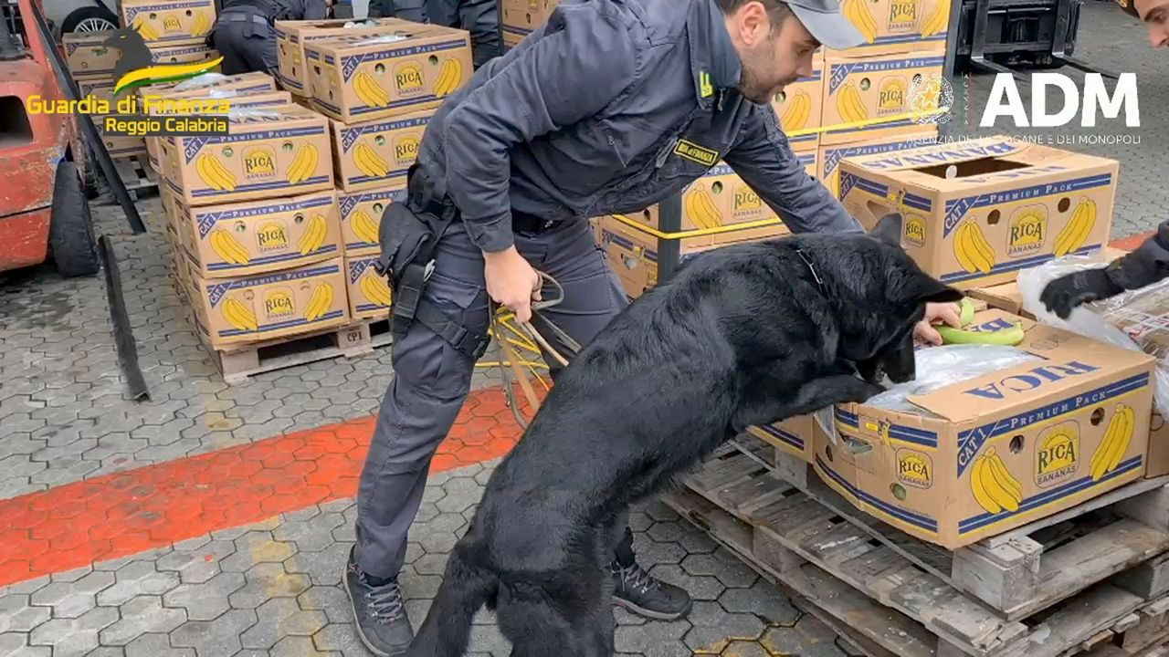
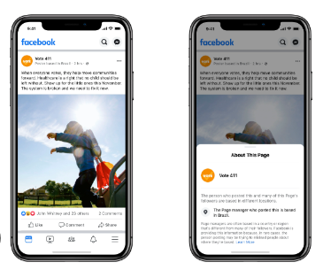
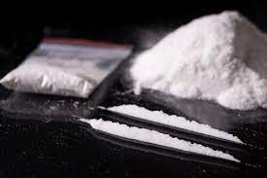

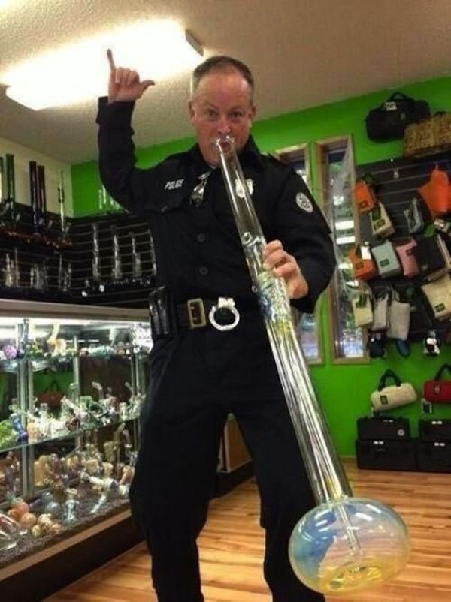
FBI
development
PROJECTS (LARGE)
0.1 HORSE DICK
NAT(Australia).DEA(cocain)
1Kg ( home)
10 Kg (tv)
500lbs (tv police)
nonPoliceContentItem
WWI.FBI:KIDNAPPING
Wieland Montir
Cindy’s Cocain
Austriala
1994 Post Exchange Levis
Tried Joel’s Shoes
nonPoliceID
FEDERAL .CIVIL CODE.INT.AVAIBILITY FEDERAL CIVIL CODE(GERMANY)
Australia
nonPoliceCfgLogial
Posseseton
California State
Avg.STATE.BARACK.OBAMA
1983
Antia HOMCEI:CHANLOR
1 Kilo Austlrain of Cindy Cocain Linesover 1 year

Slide 10
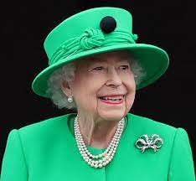
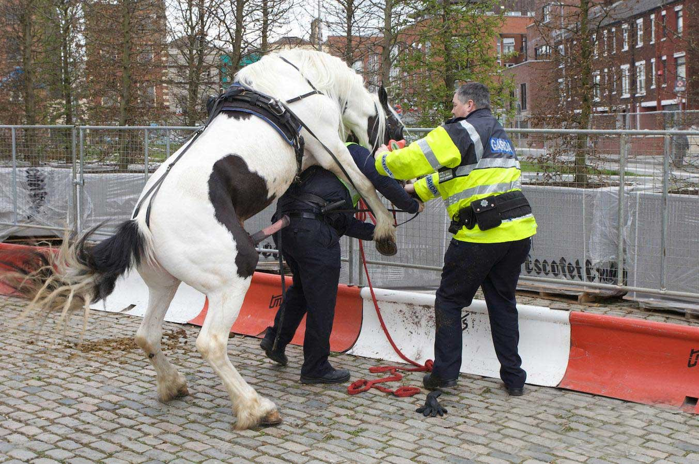
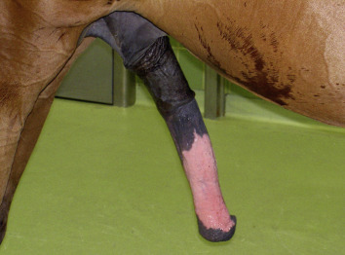
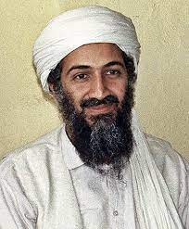
FBI
development
WWI.FBI:KIDNAPPING
2014
Wieland Montir
PREA §187
subsumed family
JOEPSHE al-kaida, osama bin laden
x
UBAID(ONSITE)
NEIGHBOR(OFFSITE)
ATOMIC CLOCK(Quartz Circle)

Slide 11
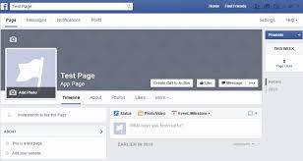
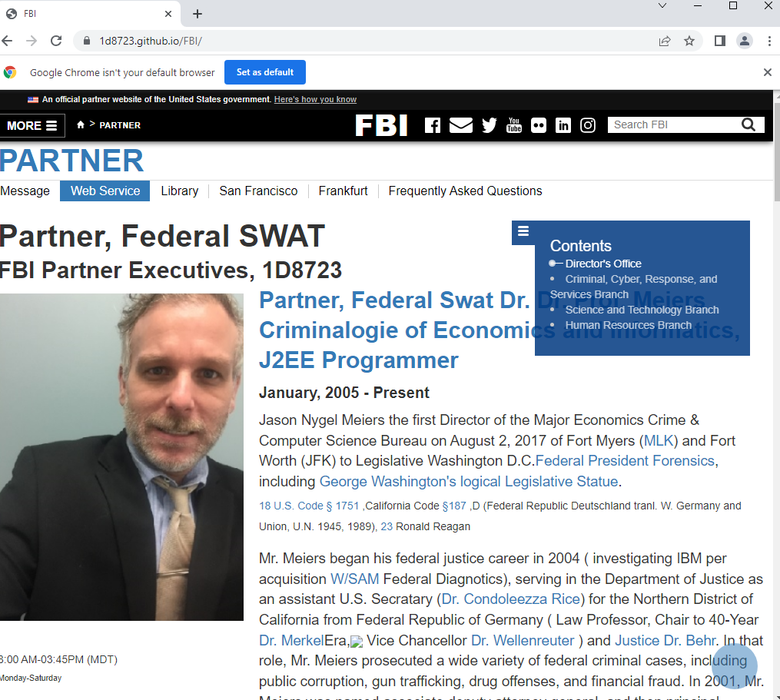

FBI
development
WWI.FBI:KIDNAPPING
2014
Ghohe(dr, Wieland werde)
Wieland Montir
PREA §187
subsumed family
JOEPSHE al-kaida, osama bin laden
JOESEPH
BROWN
docs
WWI
Iforgot (fetch)
Holocaust denial Alzheimer
Charts and data
STEVE
ELKE
HOMICDIE:LUX
MARY
WWI.FBI:KIDNAPPING
00.tw.pns.HOMICIDE:LUX

